Slide 1

Platform for automated analysis using clinical time series data
JERRY JACKY JUMANA

Slide 2






CONTENT
Introduction
Team
Marketing
AI Engine
Product
Business Plans

Slide 3



TEAM
Jerry Huang
Deep Learning & Backend
Jumana Nadir
User Interface & Application
Jacky Chow
Database & Data Pipeline

Slide 4




ADVISORS
Vijay Eranti
SJSU Professor
Google Senior Lead
Dan Harkey
SJSU Professor & Director
Ashish Jagtiani
Chronus Health CTO
Sreenath Reddy Devireddy
Chronus Health Software Developer

Slide 5

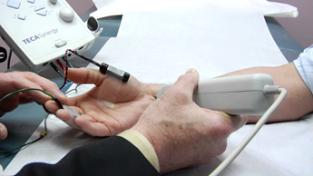

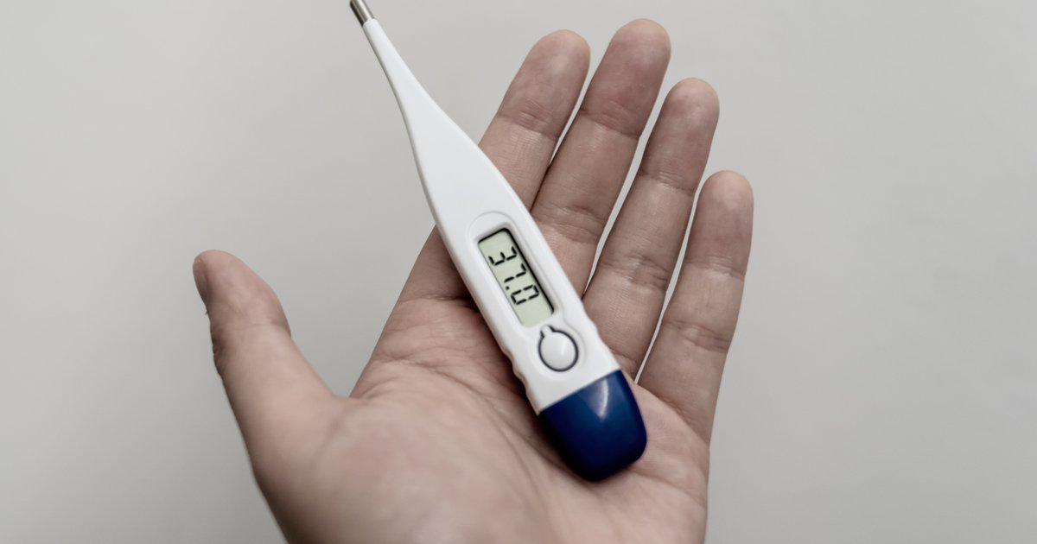

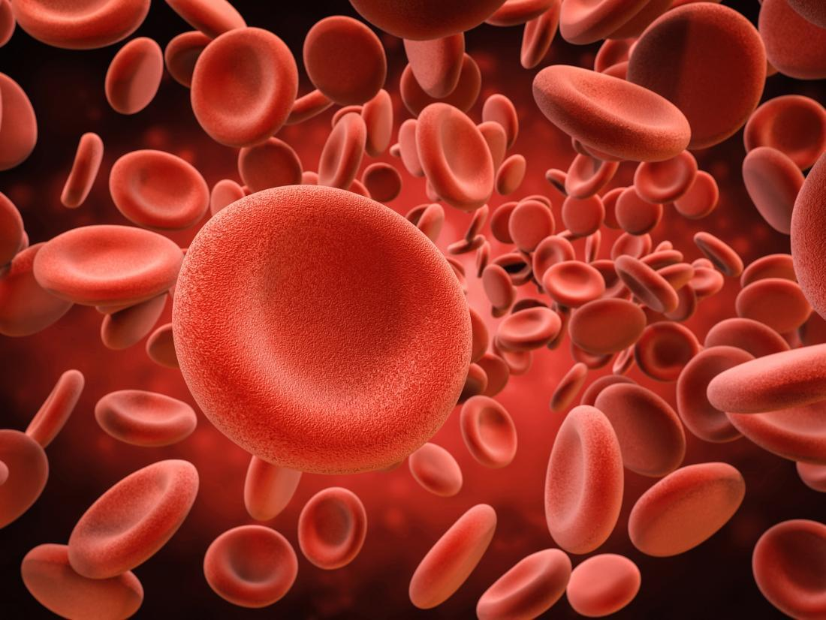
CLINICAL TIME-SERIES DATA
EEG(brain)
ECG(heart)
EMG(muscle)
Body temperature
Blood pressure
Blood cell

Slide 6




RESEARCH ON HEART DISEASES
30.3 Million Patients
12.7% adults
647,000 Death
360 Billion

Slide 7

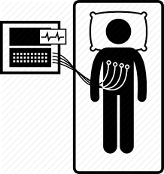

MARKETING DEMAND ANALYSIS
ECG: $50 - $87
Further ECG: $175
Body Test: $200

Slide 8

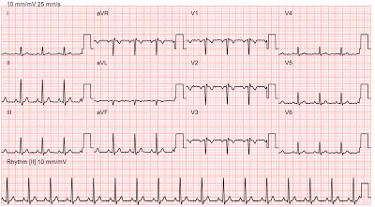


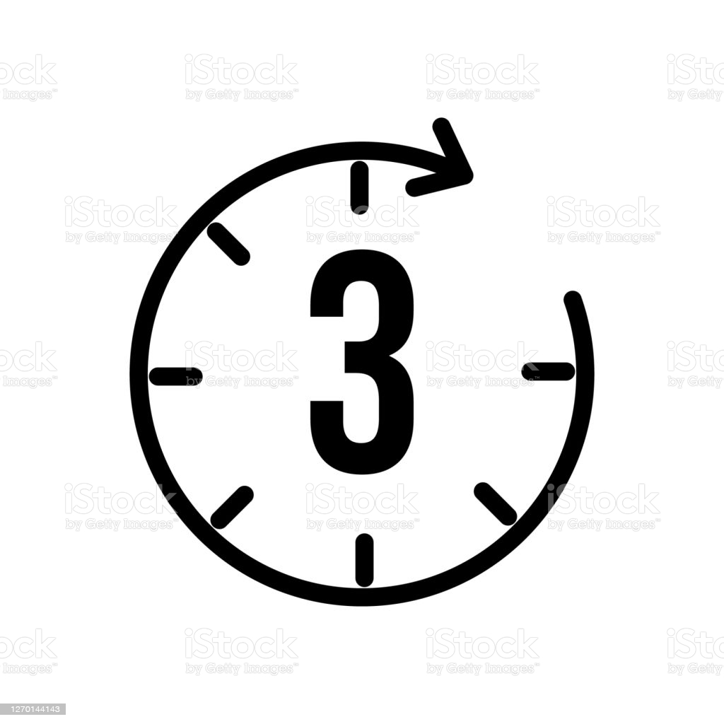


Normal ECG flow
ECG
check
double check
patients
record
1st doctor
2nd doctor
2 - 3 days
half year
everyday
30.3Million patients
33000 doctors
3 hours

Slide 9





PRODUCT
3 Seconds
93% Accuracy
Cloud-Based
Easy​
Clear Visualization

Slide 10
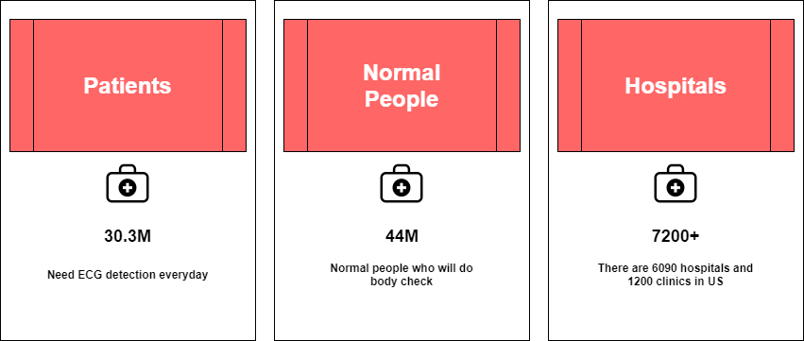
BUSINESS TO BUSINESS AND CUSTOMERS

Slide 11
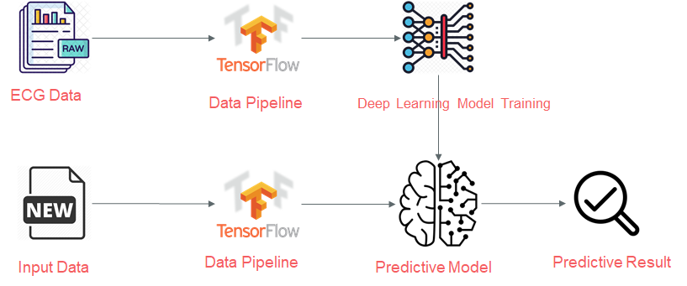
AI ENGINE

Slide 12
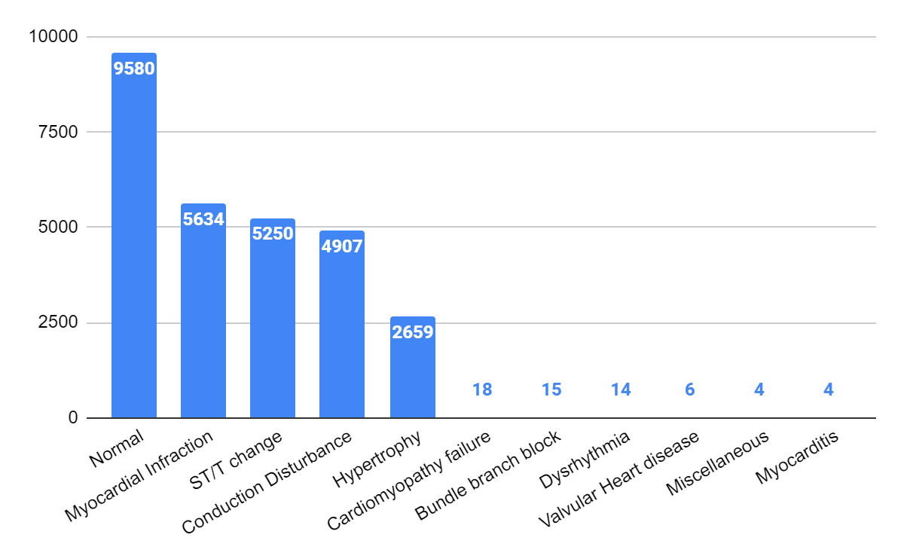
DATA Distribution
23000 Records
12 Disease Labels
19000+ patients

Slide 13
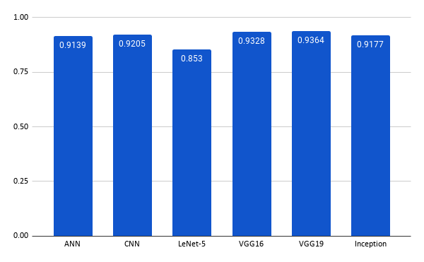
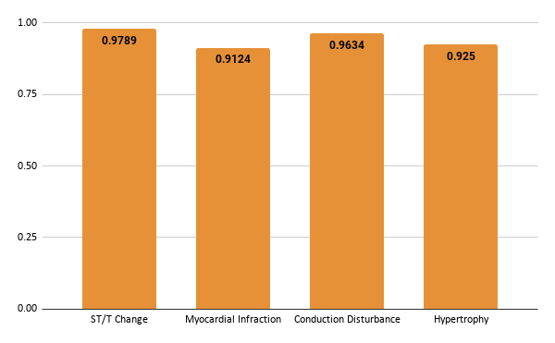
CLASSIFICATION RESULTS
Binary Class
Binary Single Feature Class Using VGG19

Slide 14


BUSINESS PLANS
Finding corporation with the Hardware system to get real time ECG data
Add more time series data AI engine

Slide 15
THANK YOU

